Slide 1
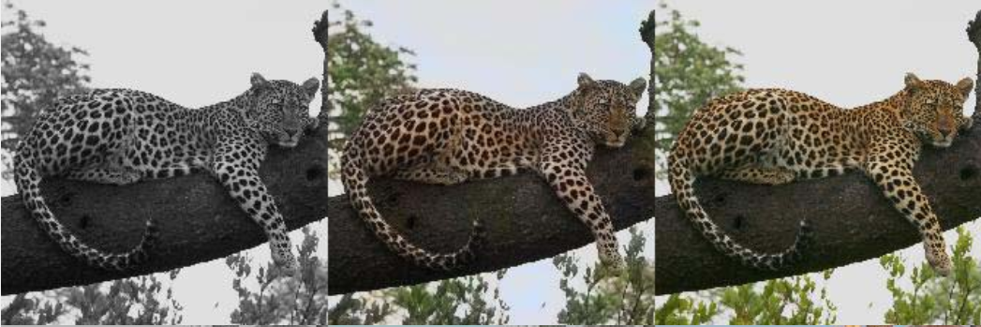
Automatic Colorization
Paper By Ryan Dahl
2016
Notes:
This is a good problem to automate because perfect training data is easy to get: any color image can be desaturated and used as an example.

Slide 2
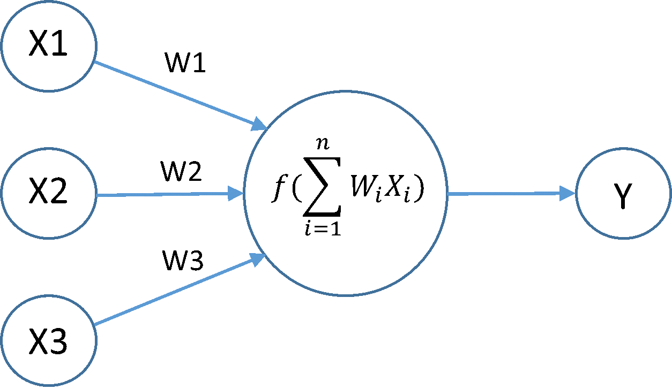
Brief Overview of Neural Network
Non linear function
A neuron
Notes:
Keep in mind that the topic Neural Network and CNN itself are a separate course. Hence I will only be giving an overview of them. I wont be providing the intution behind this concept and its history.

Slide 3

Universal Approximation theorem
We try to find the function for a problem given input and output. ( we just want to find the weights)
Loss function.(Many different loss function exist)
Apply Gradient descent on it
Many connected neurons form neural network.
Notes:
One key concept behind deep learning is the universal approximation theorem which states that a feed-forward network with a single hidden layer containing a finite number of neurons (i.e., a multilayer perceptron), can approximate continuous function. So for any problem, we just wish to find the function given an input and output. How do we do that?

Slide 4
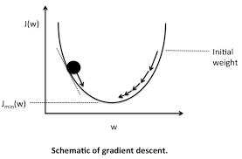
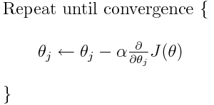
Gradient Descent
Notes:
Why gradient descent not derivative=0? Because not every function is diffrentiable 2) complexity reasons.

Slide 5

Convolutional Neural Networks (CNN)
Notes:
Most of the problems of Computer vision in Deep learning are solved using CNNs.

Slide 6
Architecture proposed by the paper
more info can be extracted than just the final classification. Zeiler and Fergus
Made use of VGG16 model.
HYPERCOLUMNS
Notes:
VGG 16 is a pretrained CNN model for image classification

Slide 7
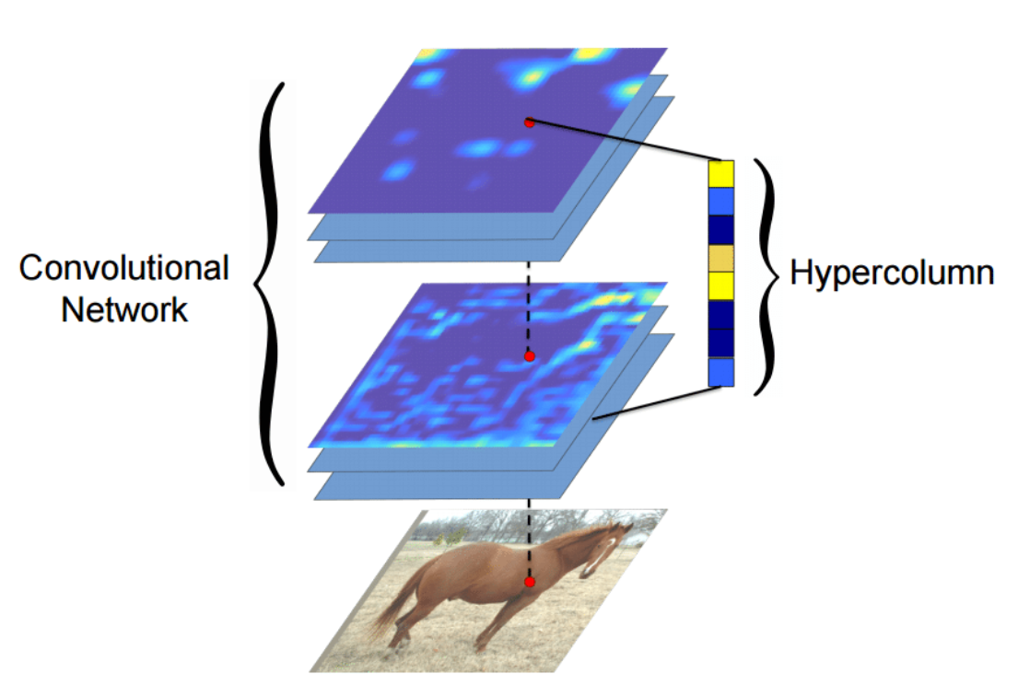
Hypercolumn
Definition: A hypercolumn for a pixel in the input image is a vector of all the activations above that pixel
Info in last FC layer: too coarse spatially
In the initial layers: spatially precise info but lack semantic info
Hypercolumns-> Best of both worlds
Q) What to do if size of feature map smaller than input image?
Ans: Bilinear interpolation
Notes:
the information in the last FC layer may be too coarse spatially to allow precise localization (due to sequences of maxpooling, etc.), on the other side, the first layers may be spatially precise but will lack semantic information. To get the best of both worlds, the authors of the hypercolumn

Slide 8
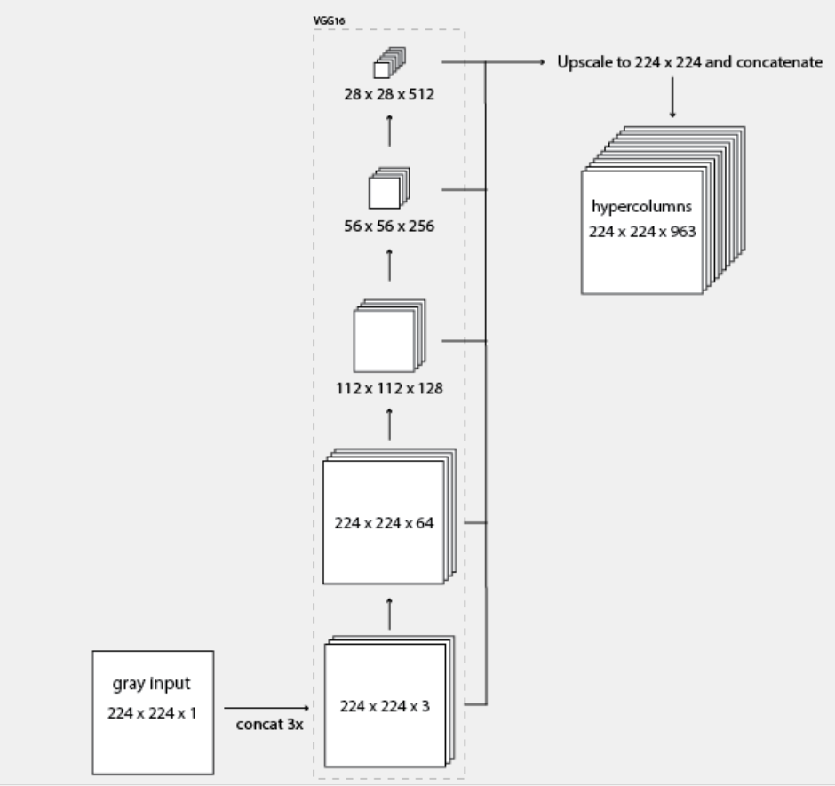
Creating the Hypercolumns….
forwarding an image through the VGG network
extracting a few layers (specifically the tensors before each of the first 4 max-pooling operations),
upscaling them to the original image size, and concatenating them all together
Using this information we should be able to color the image.
Use YUV instead of RGB.
Y-> intensity : same as input.
Notes:
Also YUV's conversion formula to and from RGB is just a matrix multiplication, HSV is more complex.

Slide 9
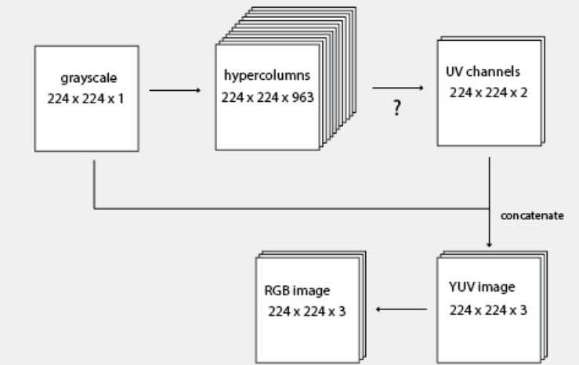
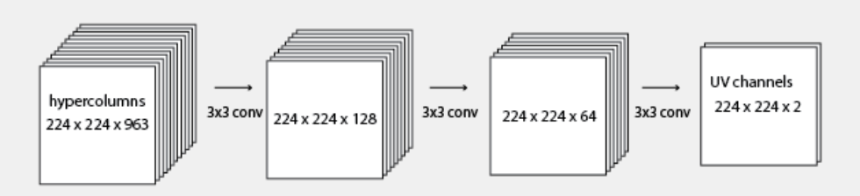
Final Architecture
In place of the question mark, we could have applied a simple matrix operation.
Unfortuantely that model is not complex enough to represent the colors in ImageNet. It will converge to desaturated images.

Slide 10
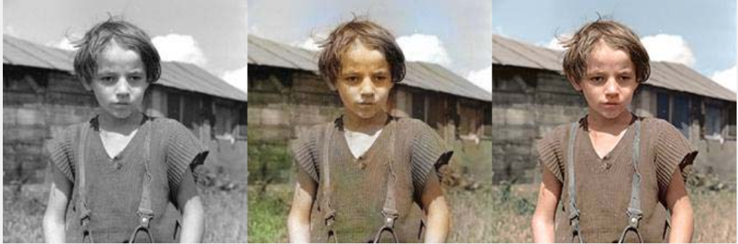
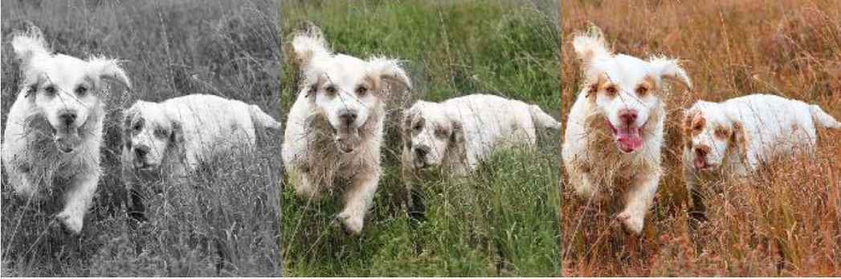
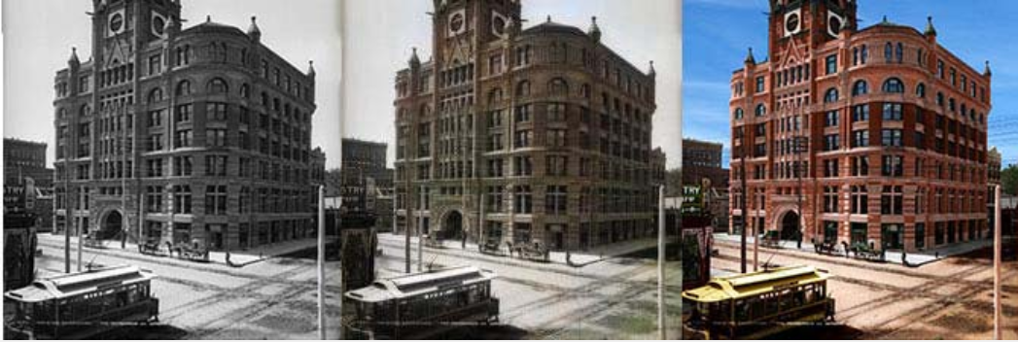
Final Output
Input Output Orignal
Input Output Orignal

Slide 11
Observations
signs of "averaging" possibilities.
we are given the "average" image
Can try to use adversarial networks to prevent this.
Notes:
If you use square loss, the model is going to get penalized a lot if it guesses that the person is "white" and the person is really "black", and vice-versa. So the model will tend to hedge its bets and produce a lot of brown people.

